Slide 1
NP-Complete Max KnapSack
Justin Newman, Jacob Shulman, Kyle LaCanna, Jackson Brantley

Slide 2
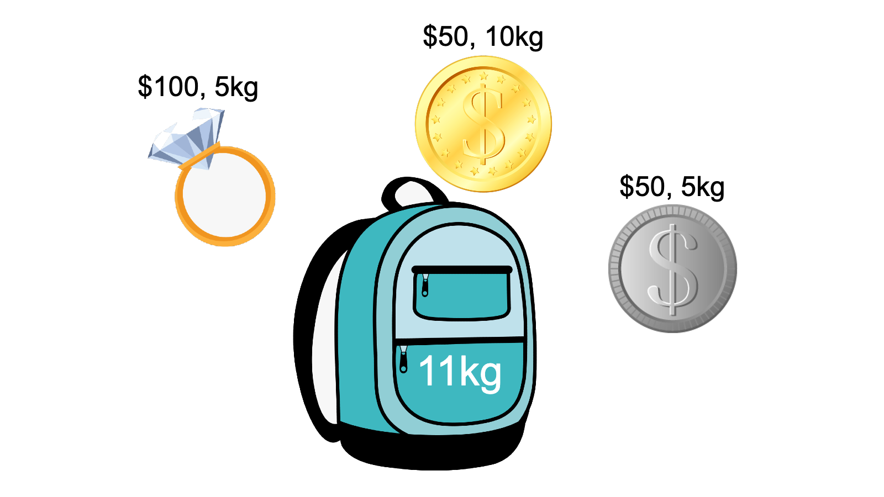
My Problem
0-1 Knapsack Problem (different than Fractional Knapsack)
Decision Problem:
Can the maximum value V be achieved without exceeding the weight W?
Optimization Version:
What is the maximum value V achievable within a given weight W?

Slide 3
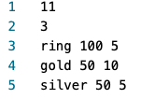
Problem Input
-- Maximum weight of knapsack
-- Number of available items
-- Items given in format: name,
value, weight

Slide 4
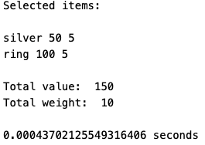
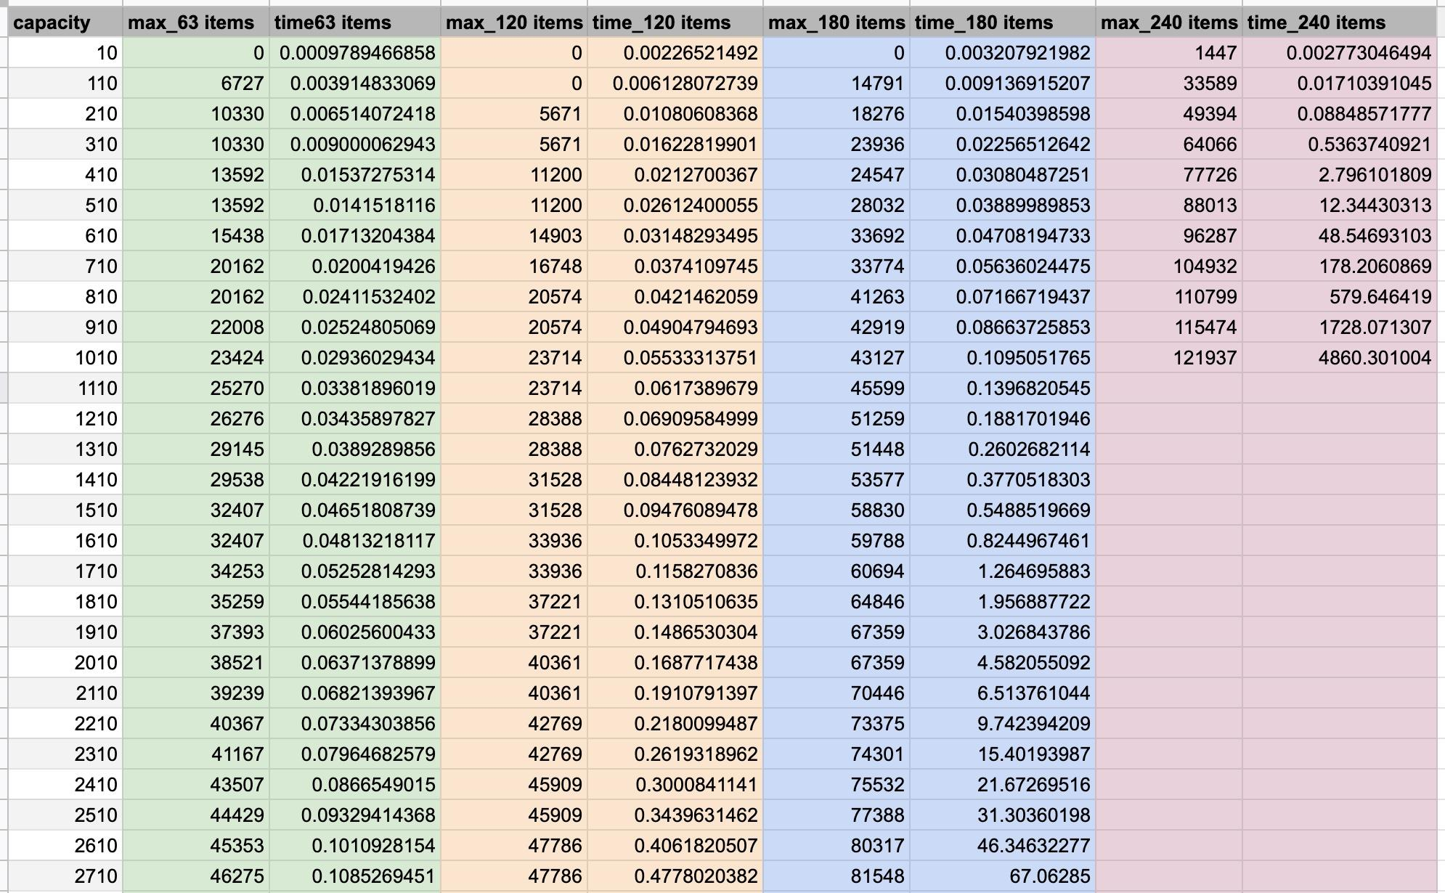
Problem Output

Slide 5

Applications
Mars Rover
Limited Capacity
Can only take the highest value items while maintaining a certain weight
Diet Tracking
Calories consumed (weight)
How full it makes you (value)
Hunger level (capacity)
Cramming for a test (from a textbook)
Number of pages per section (weight)
Importance of those pages (value)
Knowledge gained (capacity)
Burglary
Self Explanatory

Slide 6

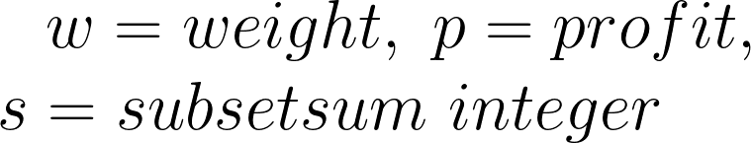


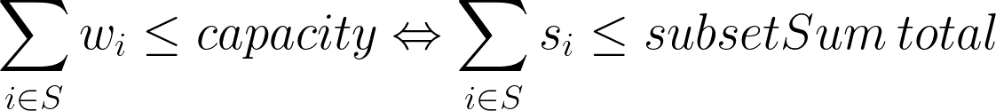
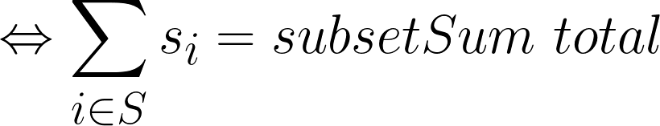
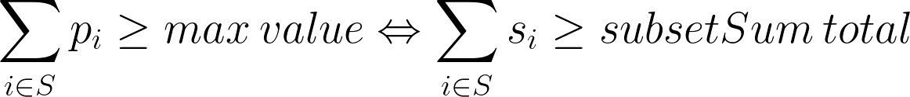
Reduction (justify its inclusion in NP-Complete)
To check if the total weight is less than or equal to the capacity and if the corresponding profit is maximized. It takes only linear time to add the weights and profits of all the goods to find the true/false result.

Slide 7
Sketch of Exact Solution (pseudo-code)
knapSack(capacity, wts, vals, n)
if n = 0 or capacity = 0 then
return 0
if wts[n-1] > capacity then
return knapSack(capacity, wts, vals, n-1)
else
return max(vals[n-1] + knapSack(
capacity-wts[n-1], wts,
vals, n-1), knapSack(
capacity, wts, vals, n-1))
end
end
-- No items to select or max capacity is 0
-- Weight of nth item exceeds the capacity of the knapsack, cannot be included in optimal solution
-- Return the maximum of two cases: nth item included, nth item not included

Slide 8
Test Cases
Created Python script that used a stepped for loop to print integers from 10-100,000 in intervals of 100.
Generated a random integer from 1-100 to select that quantity of random ”items”.
Two more random integers were generated in each iteration to decide the item’s weight and value.
All test cases used the same randomly generated list of 63, 120, 180, and 240 items with each test increasing its maximum capacity.

Slide 9
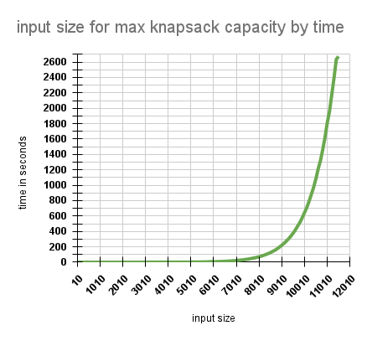
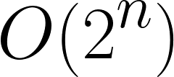
Runtime Analysis
Around input size 100, the runtime began to grow exponentially.
No real “worst case”. Performance decreases as maximum capacity increases
Items: 63

Slide 10
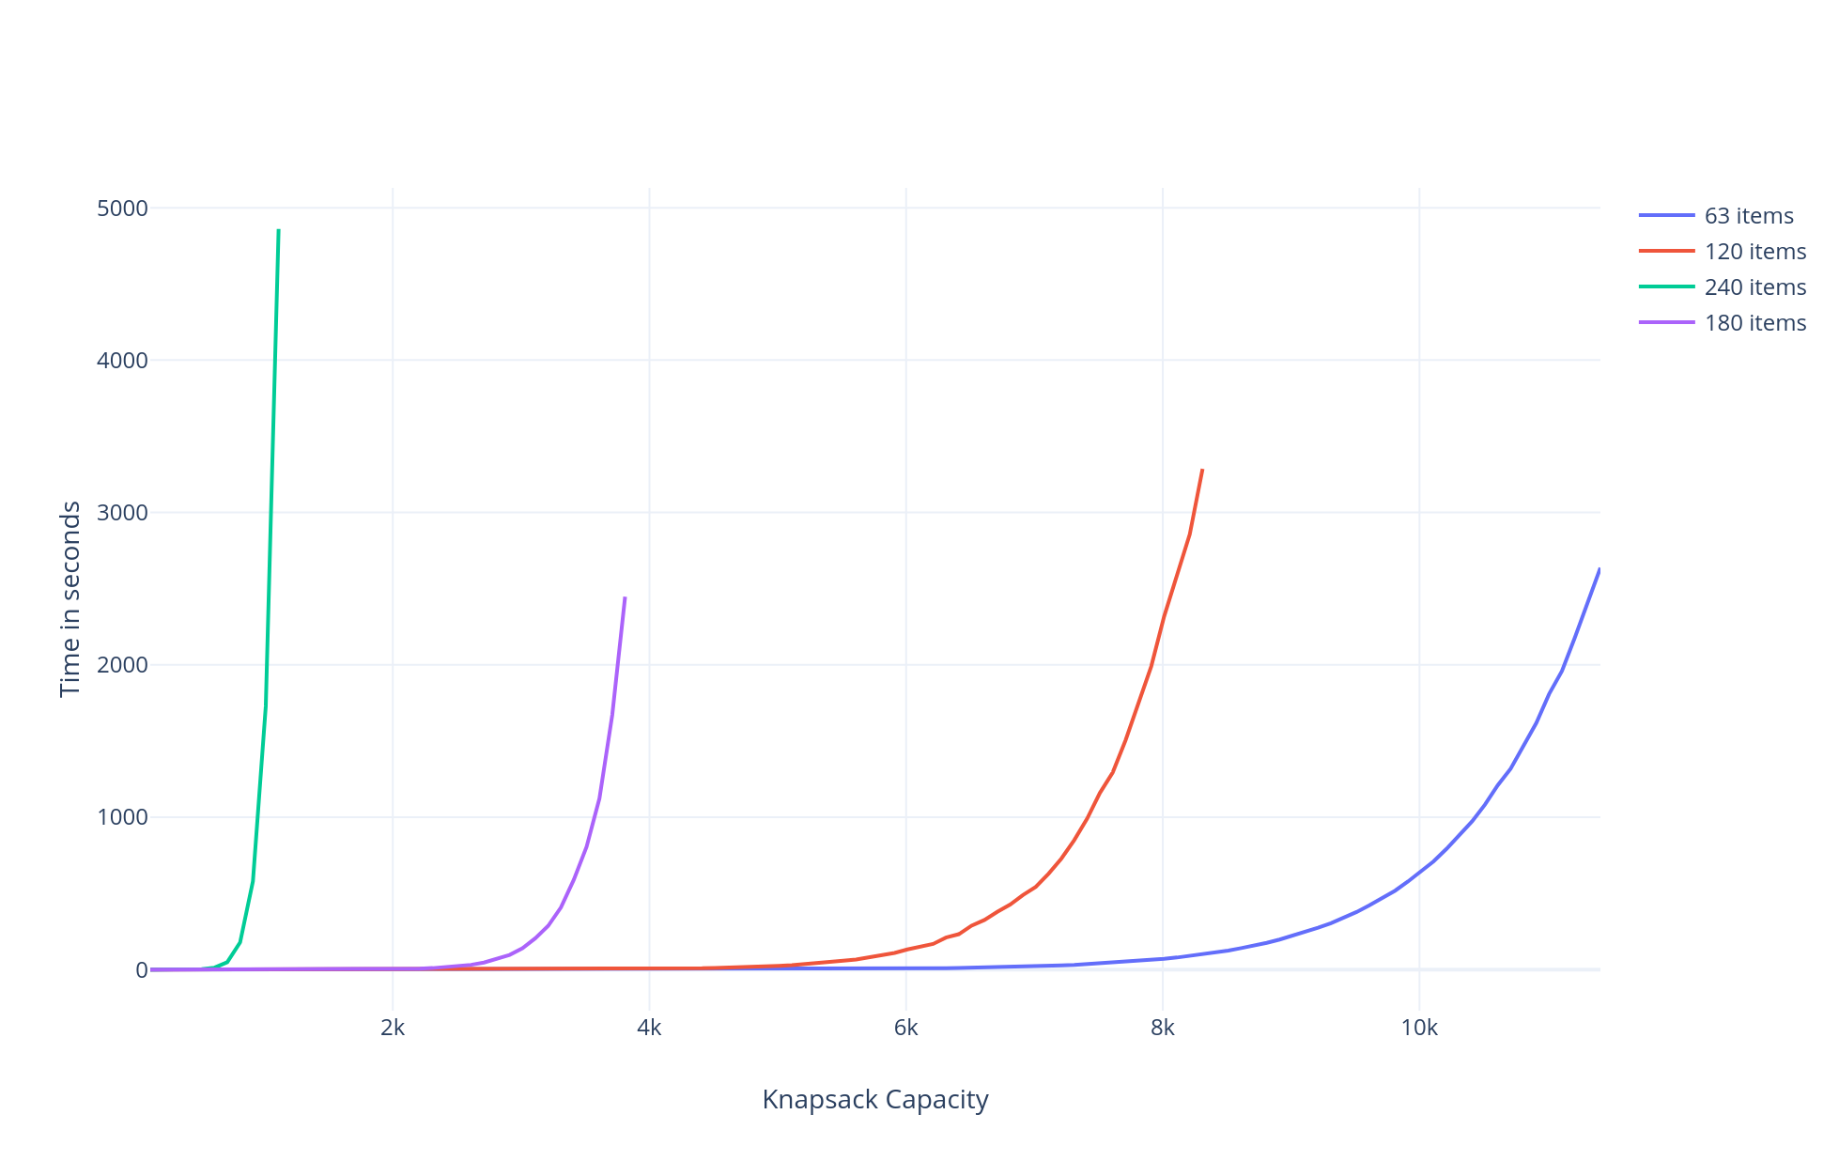
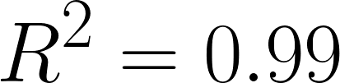
Each runtime fits an exponential trend line with a strongly correlated coefficient of determination.

Slide 11
Approximation solution
Stochastic algorithm.
Randomly pick items from the input. If the total value of those items are within a certain margin of error from the upper bound, that is the answer. If not, pick more random items.

Slide 12
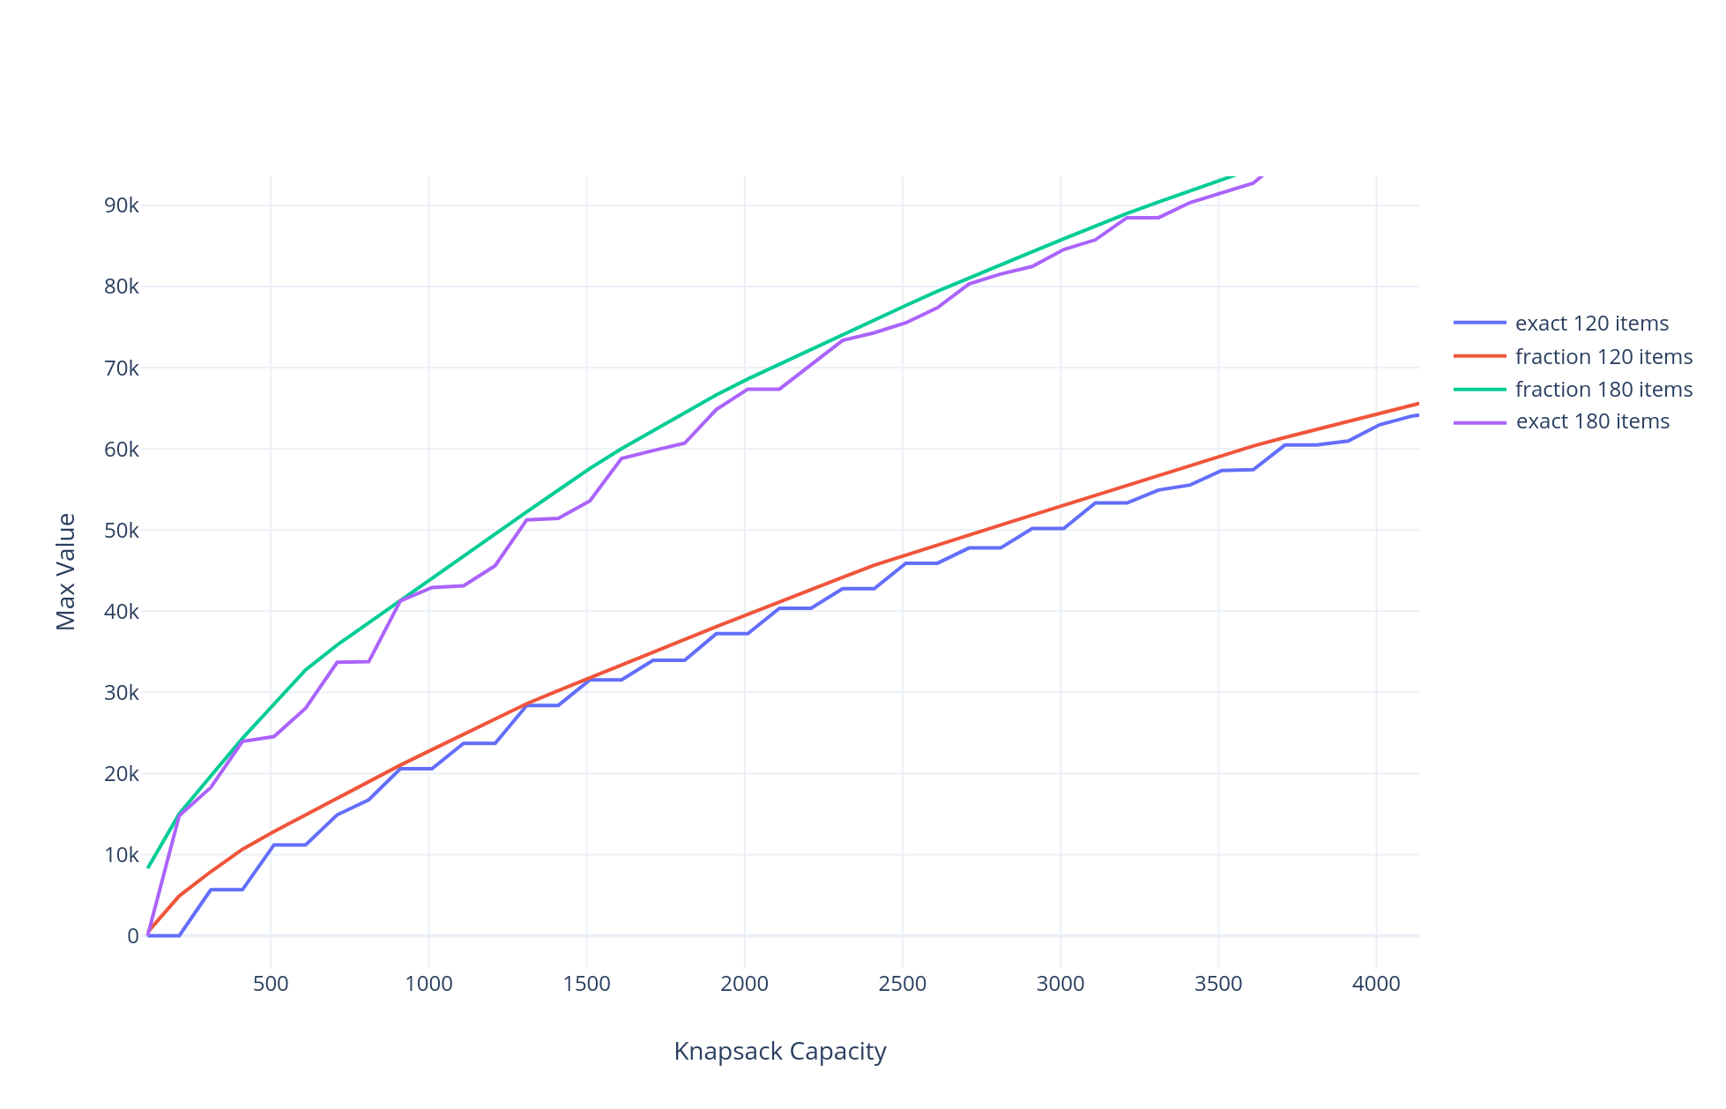
Upper Bound Analysis
Used fractional knapsack problem to upper bound the exact solution.
Problem: how close to the actual value is the approximation solution?
What we know: fractional knapsack returns the best value possible (even better than the exact solution) in polynomial time.
Need to calculate difference between fractional knapsack and exact solution and compare it to the difference between fractional knapsack and approximate solution.
Using the average percentage of difference between the upper bound and the exact solution we can figure out what the margin of error should be.

Slide 13
Pseudocode
maxKnapsackApproximate(items, upperbound, weightRemaining):
bestValue = -∞
bestList = []
error = 1
while error > .04 and time < 5 seconds
list = []
while weightRemaining > 0
randomItem = pickRandomItemToAdd(items, weightRemaining)
if randomItem is None:
break
else
list.additem(randomItem)
items.remove(randomItem)
weightRemaining -= weight(randomItem)
error = (upperbound-value(list)) / upperbound
if value(list) > bestValue:
bestValue = list.value()
bestList = list
return bestList
pickRandomItemToAdd(items, weightRemaining):
startWeightIndex = -1
for i in range(weights)
if weights[i] <= wRem:
startWeightIndex = i
break
if startWeightIndex = None:
return None
randomIndex = randomNumber(startWeightIndex, length(weights))
return weights[randomIndex]

Slide 14

Runtime Analysis
The algorithm contains a while loop that could run forever based on inputs but gets manually stopped if it runs longer than 5 seconds.
Within the while loop is another while loop but it halts after running at most w(max weight) times.
O(nlog(n)) time comes from using python’s sorting methods.
The larger the input the more time sorting takes and the less time the algorithm has to try random combinations in the specified time.

Slide 15
Special Cases
Example when the approximate solution does not find the best answer:
If the all the possible items are bigger than the bag size then the algorithm will run until forced timeout.
When the input size is so large it takes longer to sort the items than it has time to try random combinations to find a solution.
It needs to be able to try more combinations

Slide 16
Accuracy
Based off Two Factors
Time allowed
The more time allowed to bigger inputs the more time it has to try different combinations and try to yield a more accurate approximation.
The better the CPU will also affect accuracy for the given time limit since a CPU that can run instructions faster will be able to try more combinations in the set time.
Margin for error
The lower the margin for error, the longer it will take to find a solution within that margin.
The higher the margin for error is will significantly reduce the runtime of any input size since it won't have to try as many combinations before finding an approximate solution.

Slide 17
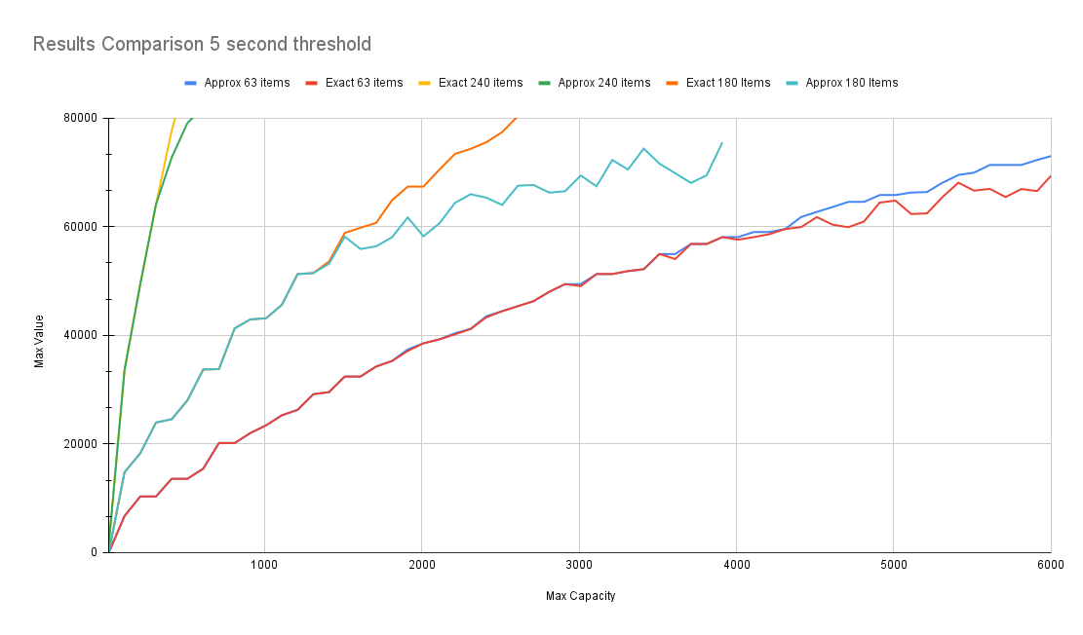

Slide 18
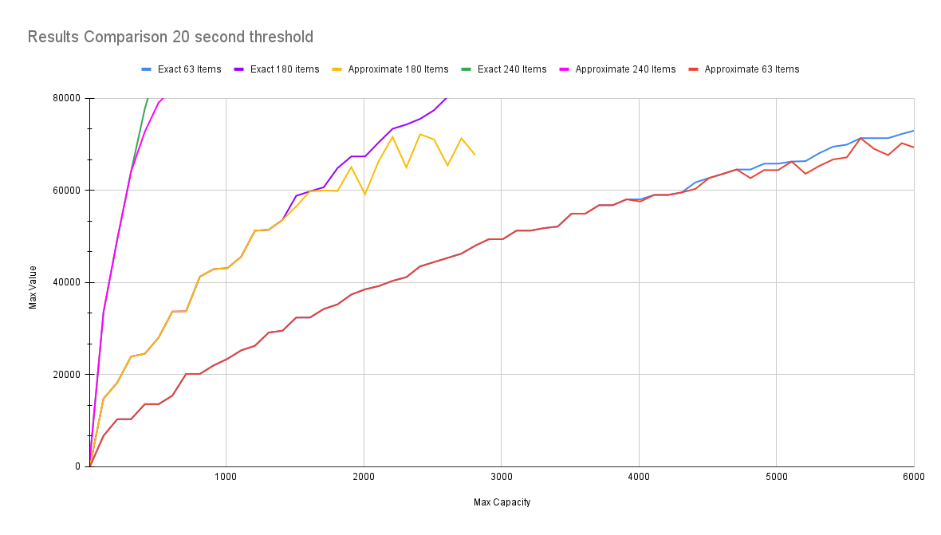

Slide 19
